Slide 1


PRESENTS
BUSINESS ANALYST CAREER PROGRAM (CHATGPT INCLUDED)
Capstone Project
Presentation
By Neeti Kishor Patel
Email- neetip33@gmail.com

Slide 2
Agenda
Exploring the Data
Statistical Examination with Excel
Creating Graphical Representations with Excel
Inserting Data into SQL Server
Validating Data Import into SQL
Importing Data from SQL Database into Power BI
Building an Interactive Dashboard
Findings
Drawing Conclusions
Making Inferences
Supplementary Information

Slide 3
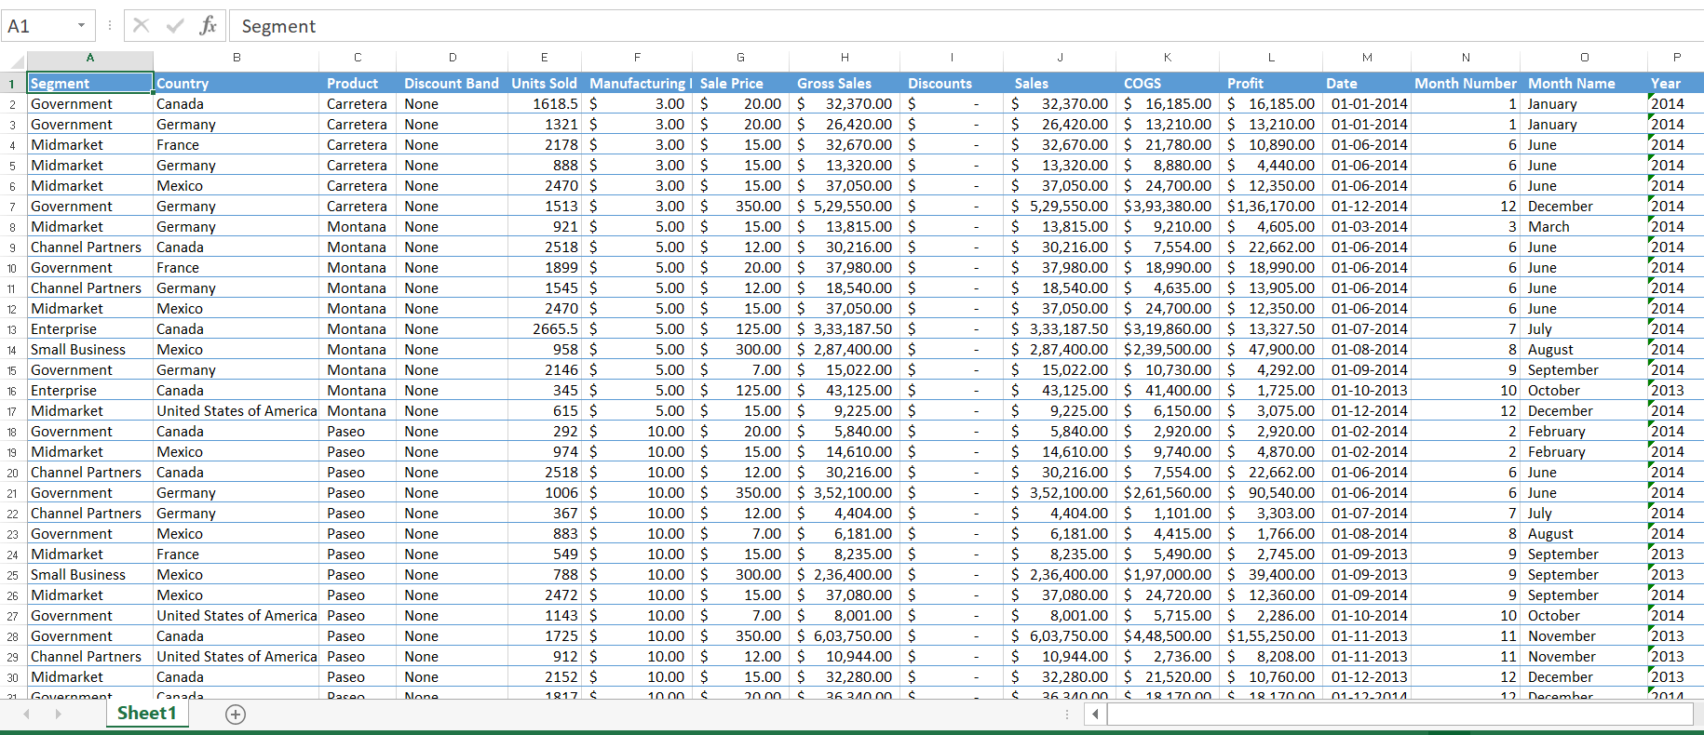
Exploring the Data
Dataset Overview: Includes financial data from various Western countries, covering multiple variables related to sales and profitability.
Key Columns: Segment, Country, Product, Discount Brand, Units Sold, Manufacturing Price, Sale Price, Gross Sales, Discount, Sales, COGS, Profit, Date, Month Number, Month Name, Year.
Data Volume and Period: Contains 700 rows and 16 columns, spanning a period of 2 years

Slide 4
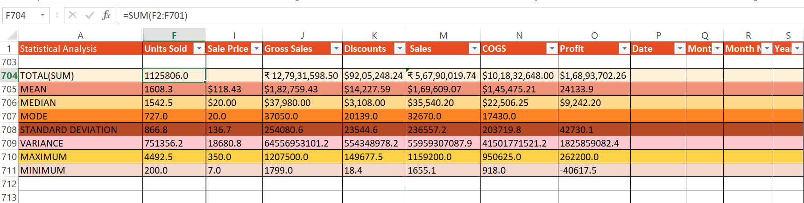
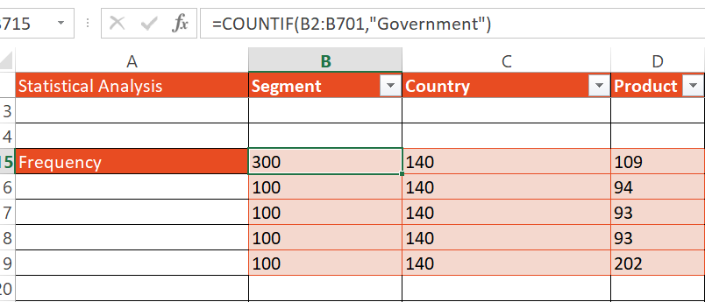
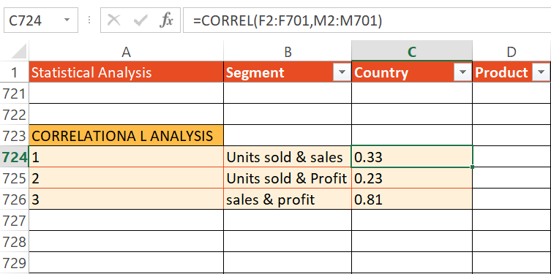
Statistical Examination with Excel

Slide 5
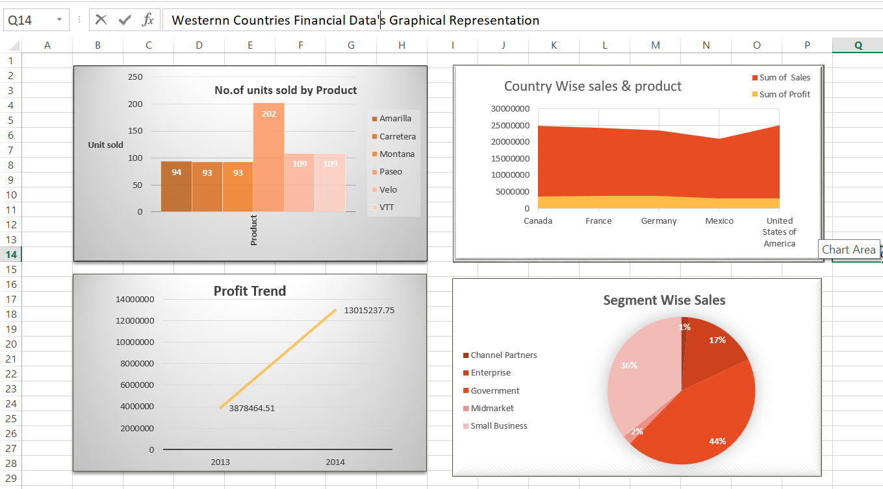
Creating Graphical Representations with Excel

Slide 6
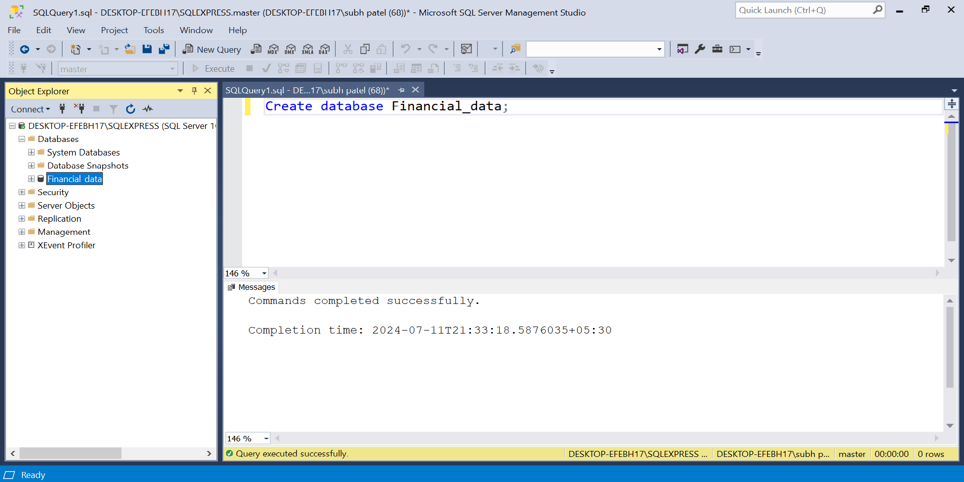
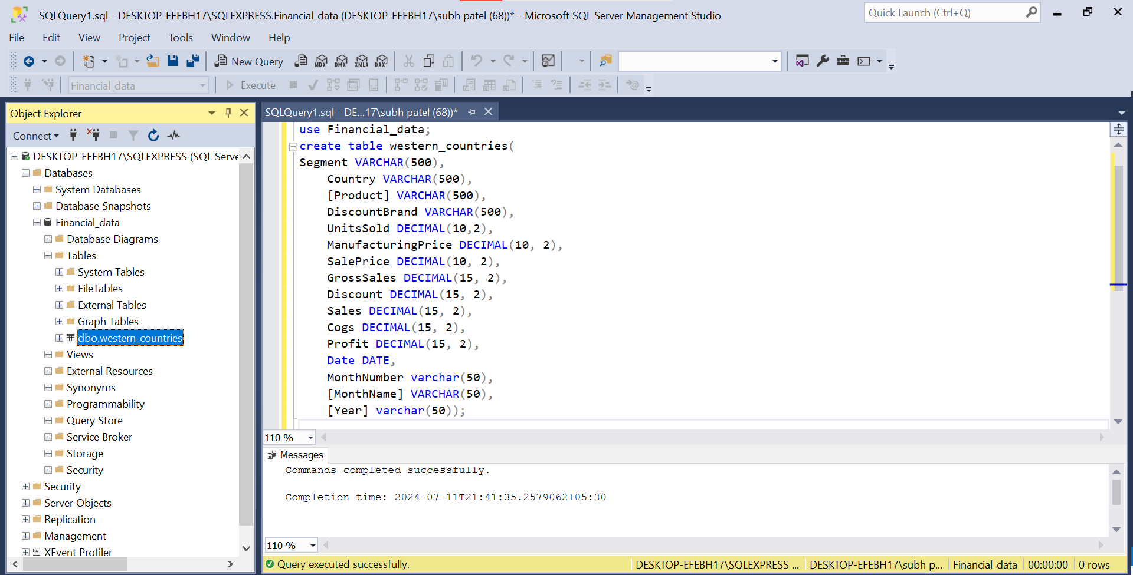
Inserting Data into SQL Server

Slide 7
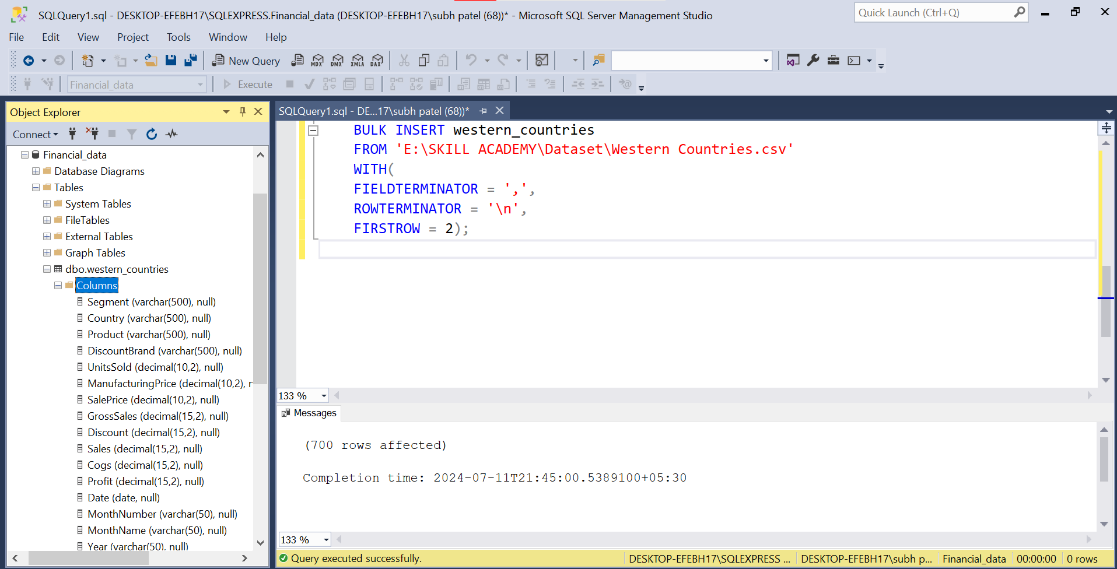
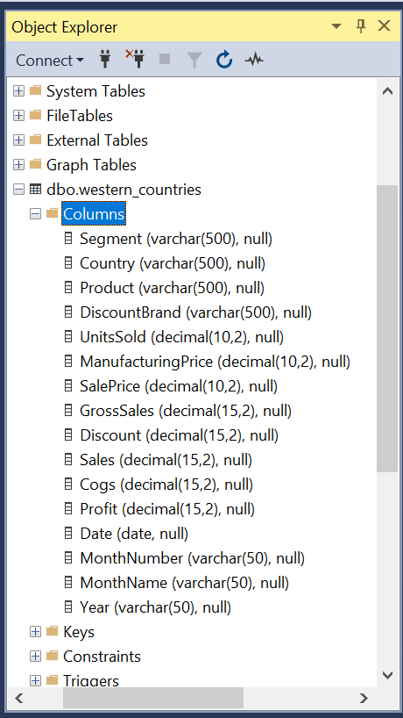
Inserting Data into SQL Server

Slide 8
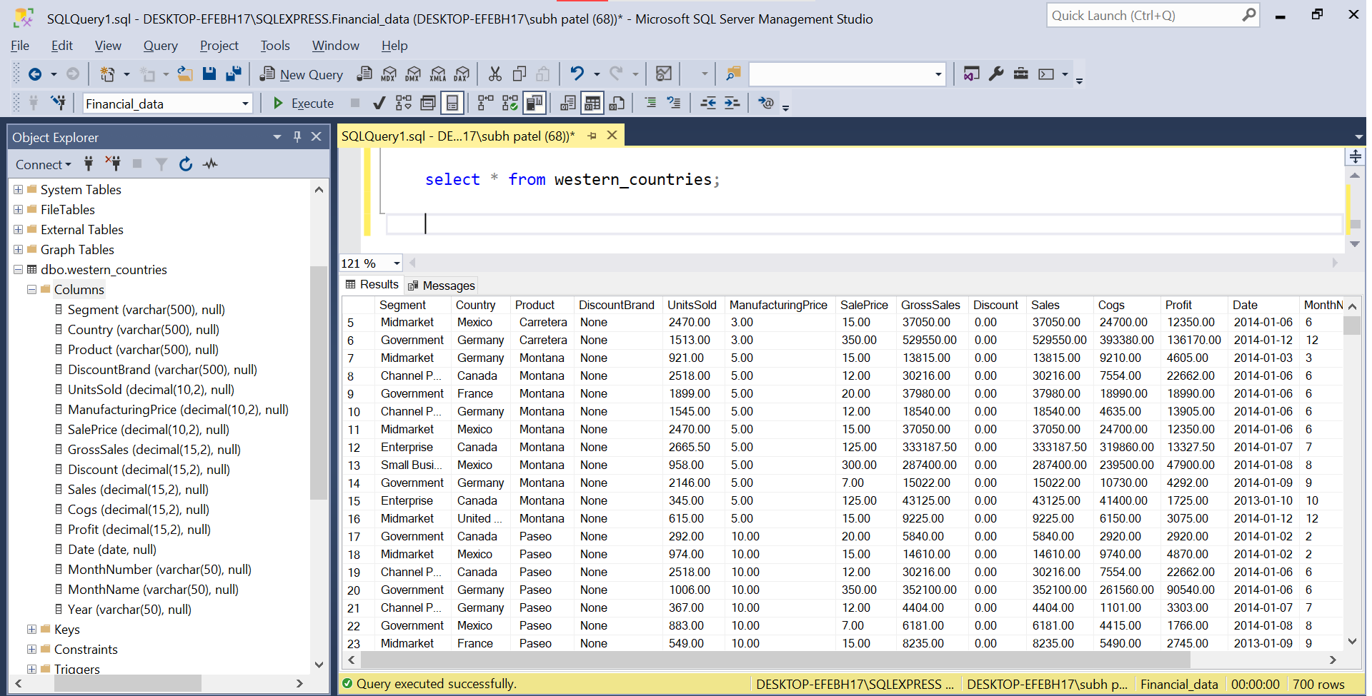
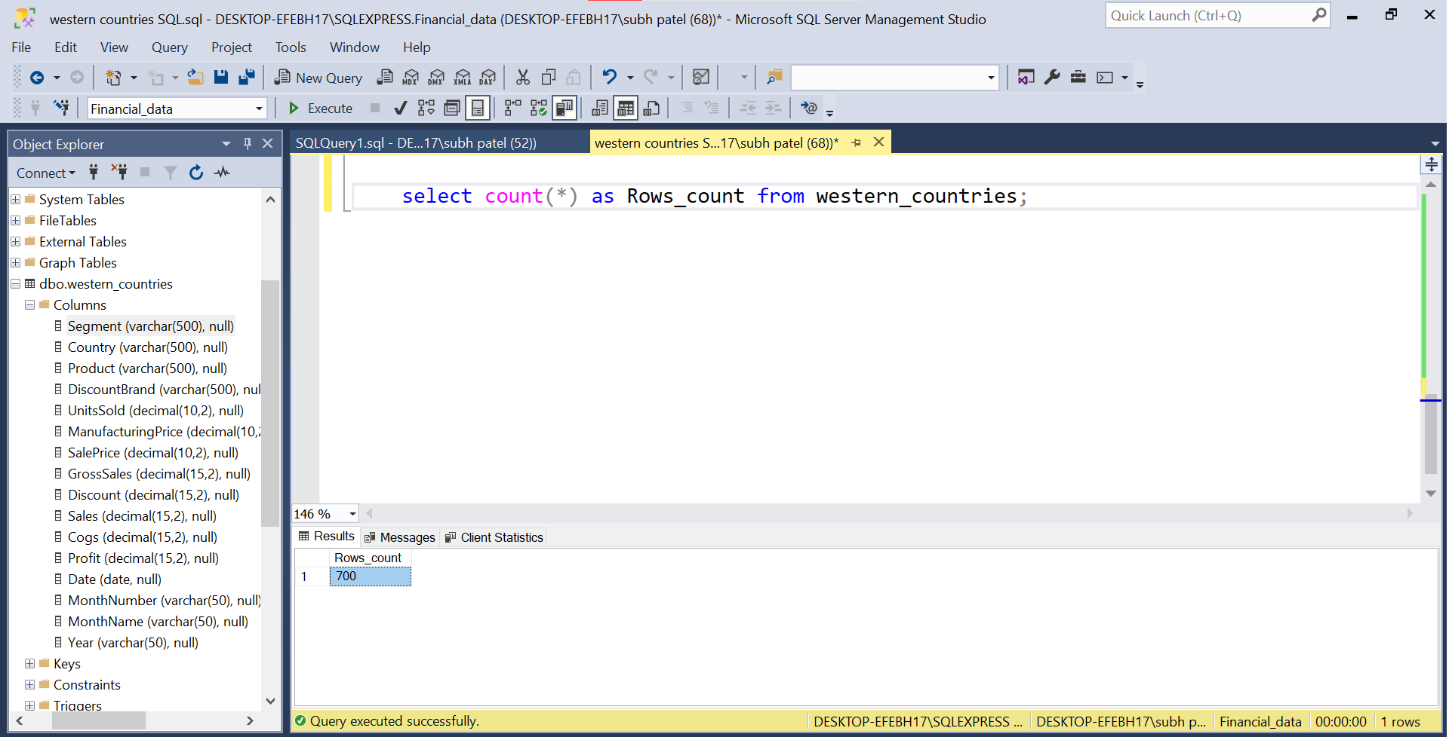
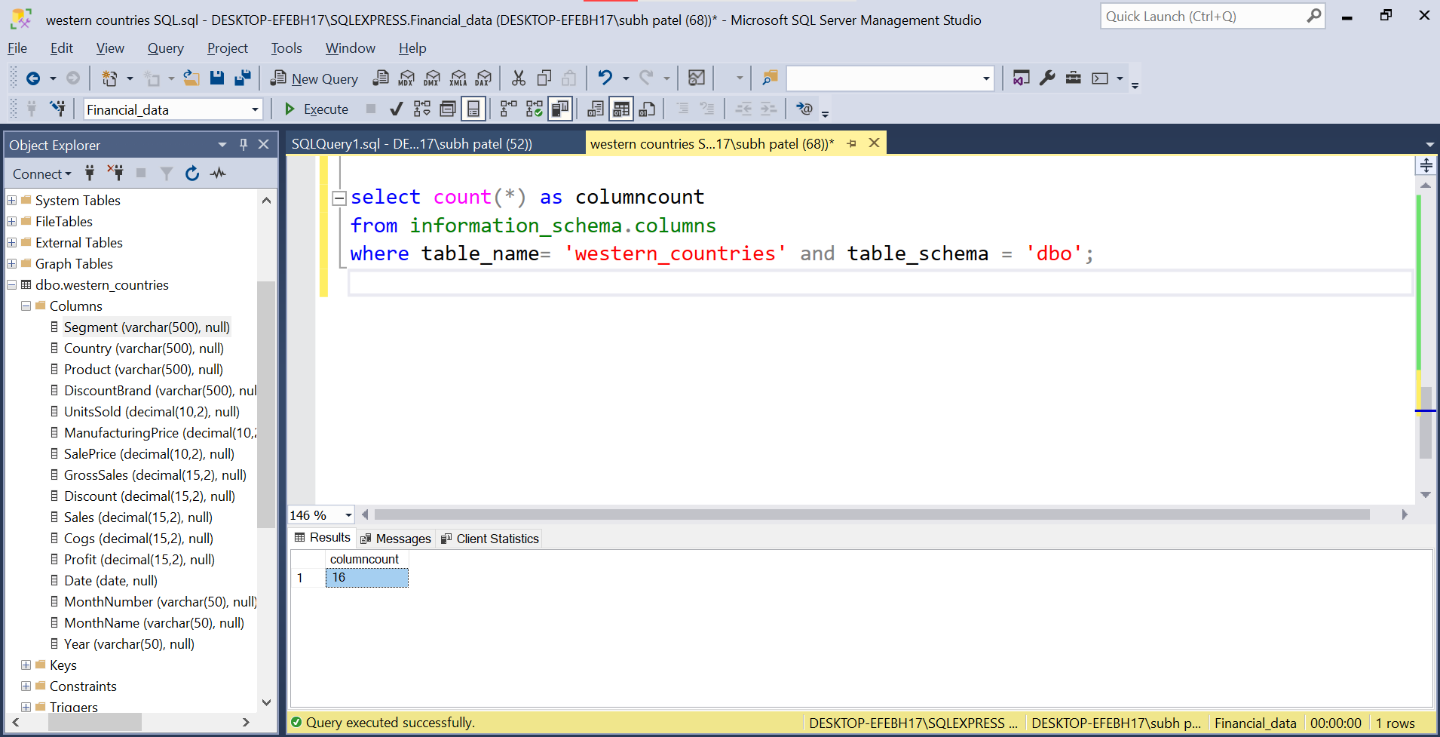
Validating Data Import into SQL

Slide 9
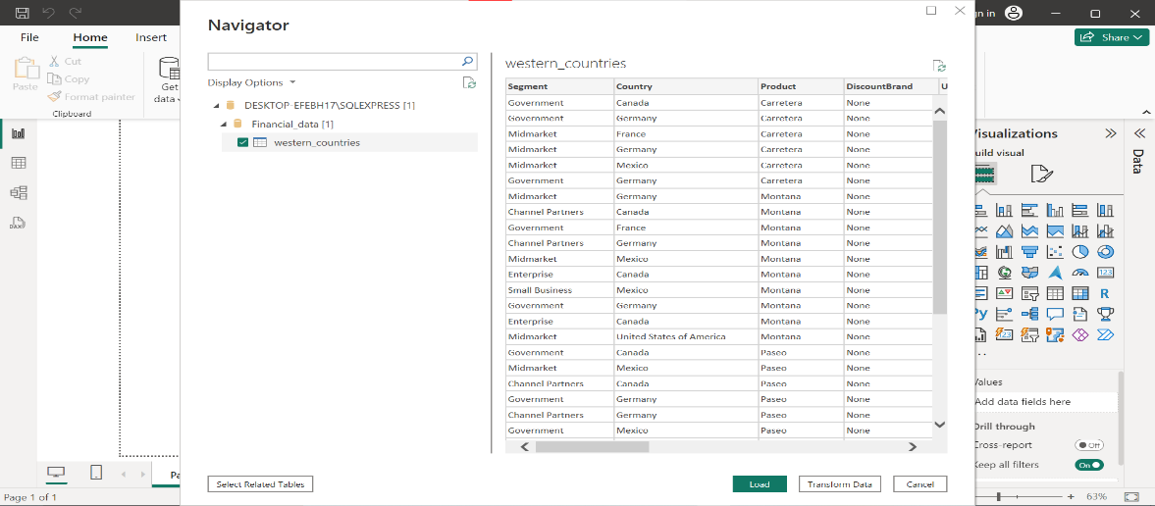
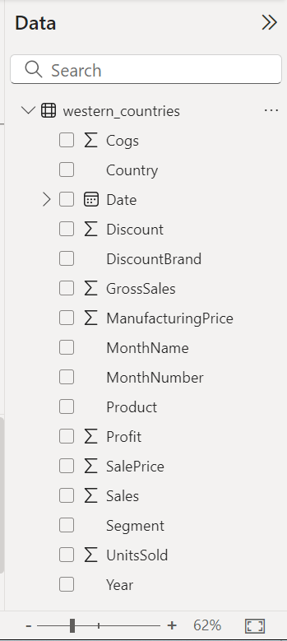
Importing Data from SQL into Power BI
Picture 1. Navigating Data (SQL SERVER)
Picture 2. Data View

Slide 10
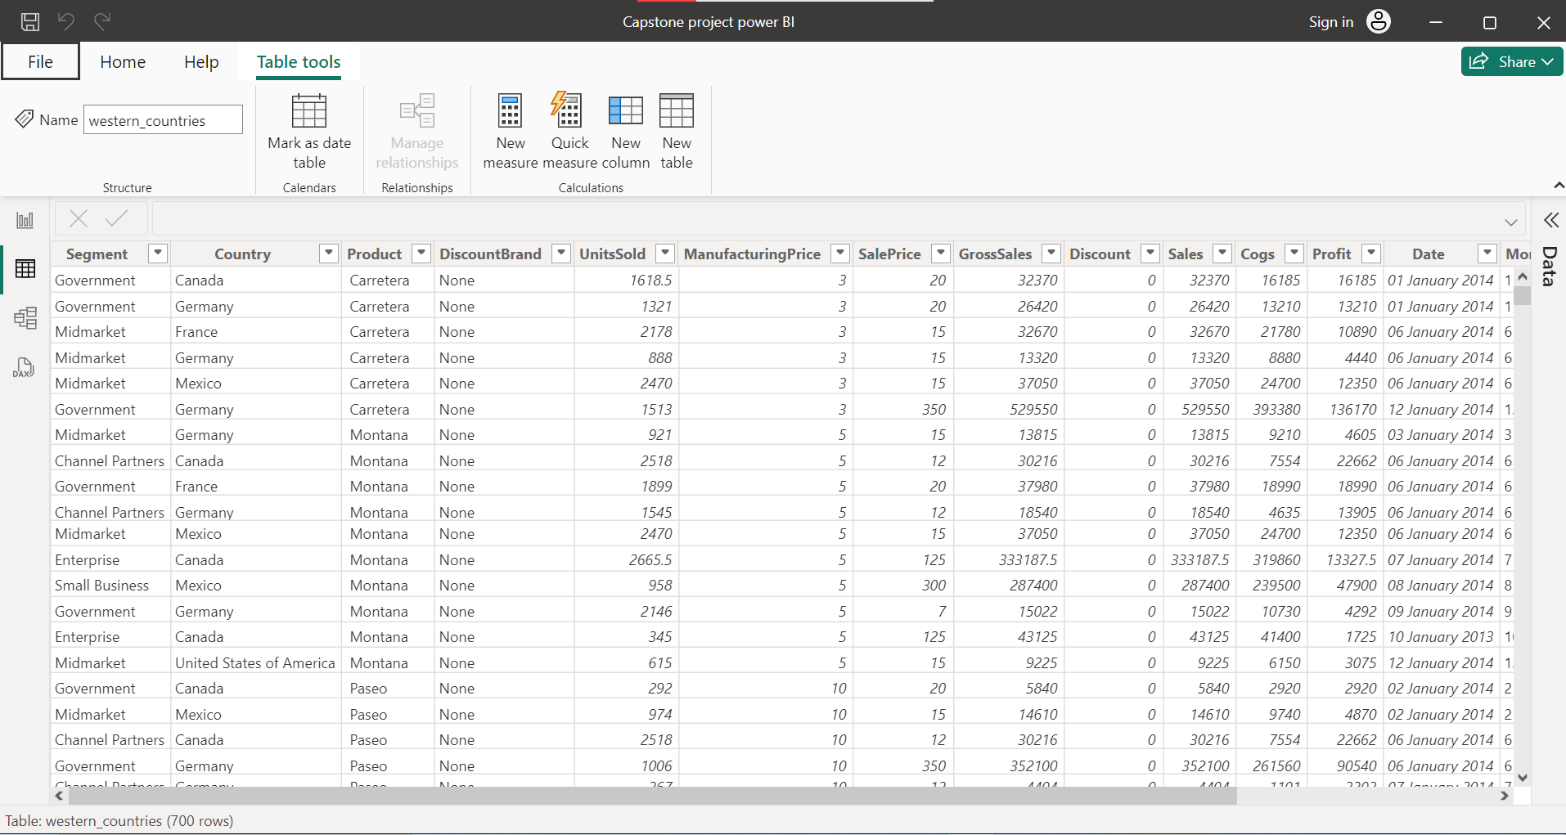
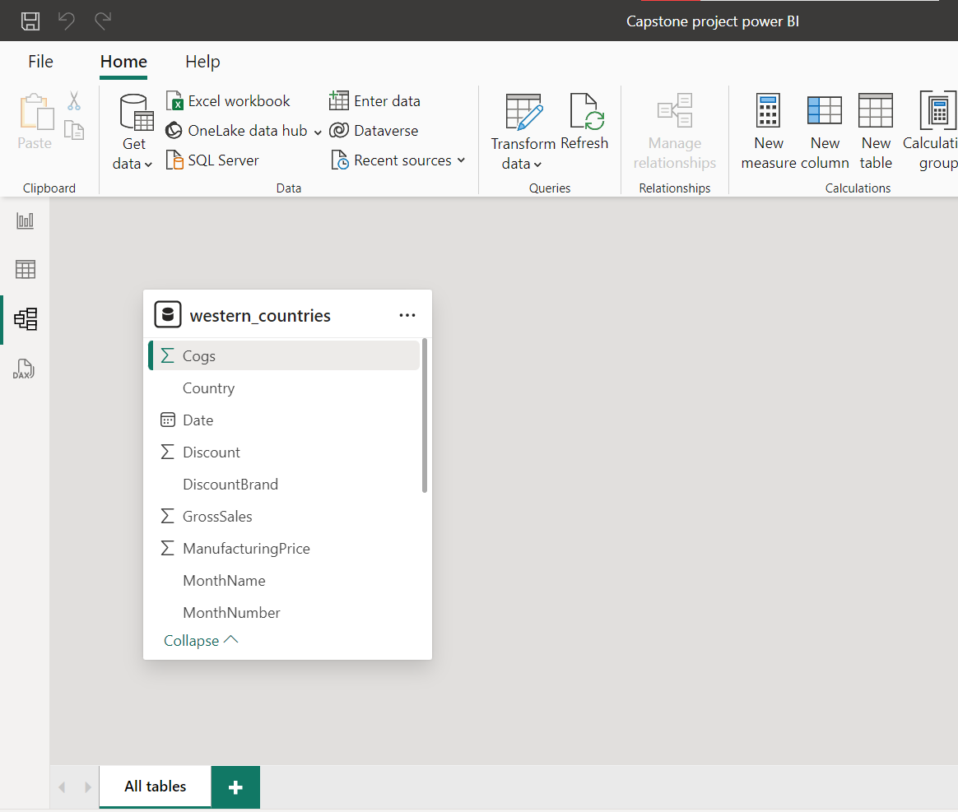
Importing Data from SQL into Power BI
Picture 2. Table view
Picture 4. Model view

Slide 11
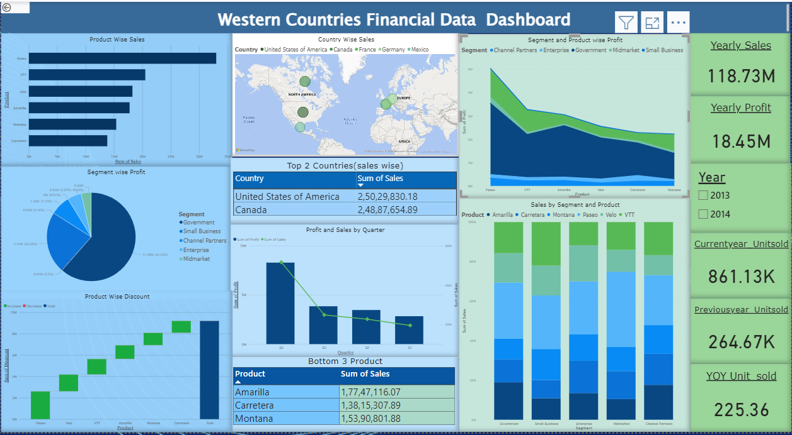
Building an Interactive Dashboard

Slide 12
Findings
The product "Paseo" achieved the highest sales, totaling $3,30,11,143.96, while "Carretera" had the lowest sales at $13,815,307.89.
Approximately 62% of the total profit came from the Government segment, whereas the Midmarket segment contributed the least, around 4%.
Sales in 2014 were nearly 3.49 times higher than in 2013.
Germany had the highest sales. USA, France, and Canada had similar sales figures, while Mexico had the lowest.
Sales and profits were highest in the fourth quarter and decreased in each preceding quarter.
The increased sales in 2014 resulted in higher profits for that year.
Germany and Canada were the top two countries in terms of sales.
The products "Montana," "Amarilla," and "Carretera" were the lowest-selling items.
The product “Paseo" received the highest discounts.
The number of units sold grew by 225.4% from the previous year

Slide 13
Drawing Conclusions
The company performance has been exceptionally strong, with remarkable growth in sales and units sold year-over-year. The data indicates successful strategies in key segments and markets, driving substantial profits, particularly from the Government segment. However, there are disparities in performance across different products and regions, suggesting areas for potential improvement. Seasonal trends significantly influence quarterly sales and profit, with the fourth quarter consistently outperforming the others.

Slide 14
Making Inferences
Focus on the Government segment to maximize profitability.
Improve strategies for lower-performing products and markets like "Carretera" and Mexico.
Leverage successful fourth-quarter strategies to boost performance in earlier quarters.
Monitor the impact of discounts on profitability, especially for products like “Paseo”.
Sustain and replicate the factors contributing to the high year-over-year growth.

Slide 15
Supplementary Information
Important links:
Excel :
https://1drv.ms/x/c/7bdbc043b7f8d48f/EReg2-LW2G5NoiizqTV8c2AB3qASe2TQeeZ8Xev_dchdVQ?e=S2gbqB
SQL server : https://1drv.ms/u/c/7bdbc043b7f8d48f/EVwRRyYTE0dEicEbGU7KHM8BZGxYzpenYrIn9OLLfG98dg?e=SiASoW
Power BI : https://1drv.ms/u/c/7bdbc043b7f8d48f/EZjdrR0q7uhNsoEWOmjsyM8BocnH10CUgSDzyVmvKQeTwg?e=2aObGj

Slide 16
THANK YOU!

